Slide 1
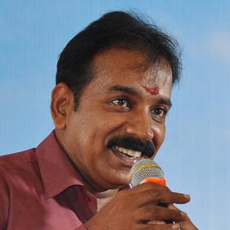
Annual Report by
Mr.A.G.Prakash Nair, Principal
MA(Eng)., MA(Soc)., LL.B., LL.M., MBA., PGDJ., B.Ed.,

Slide 2
Knowledge partners

Slide 5
Scholastic Programmes

Slide 6
Kinder Garden – Montessori System
Class 1 to 12 – CBSE system

Slide 7
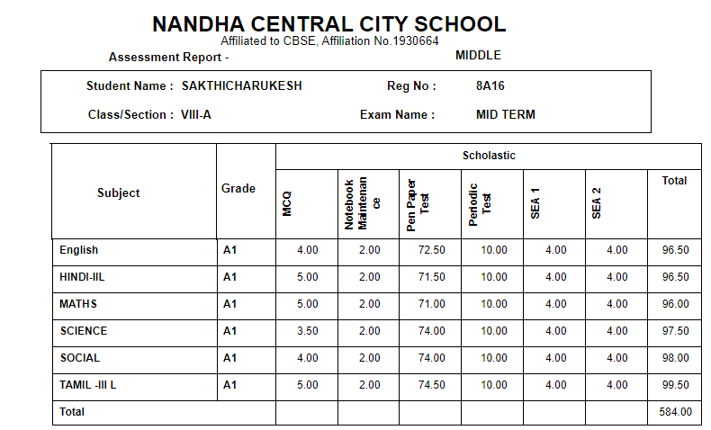
assessments through cbse

Slide 8
CBSE ORIENTATION FOR PARENTS

Slide 9
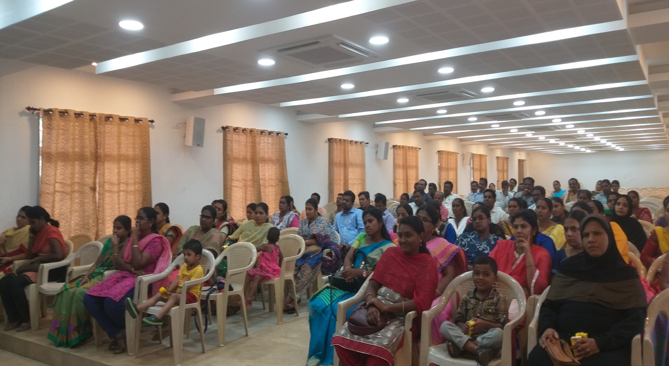

Slide 10
OPEN DAY

Slide 11
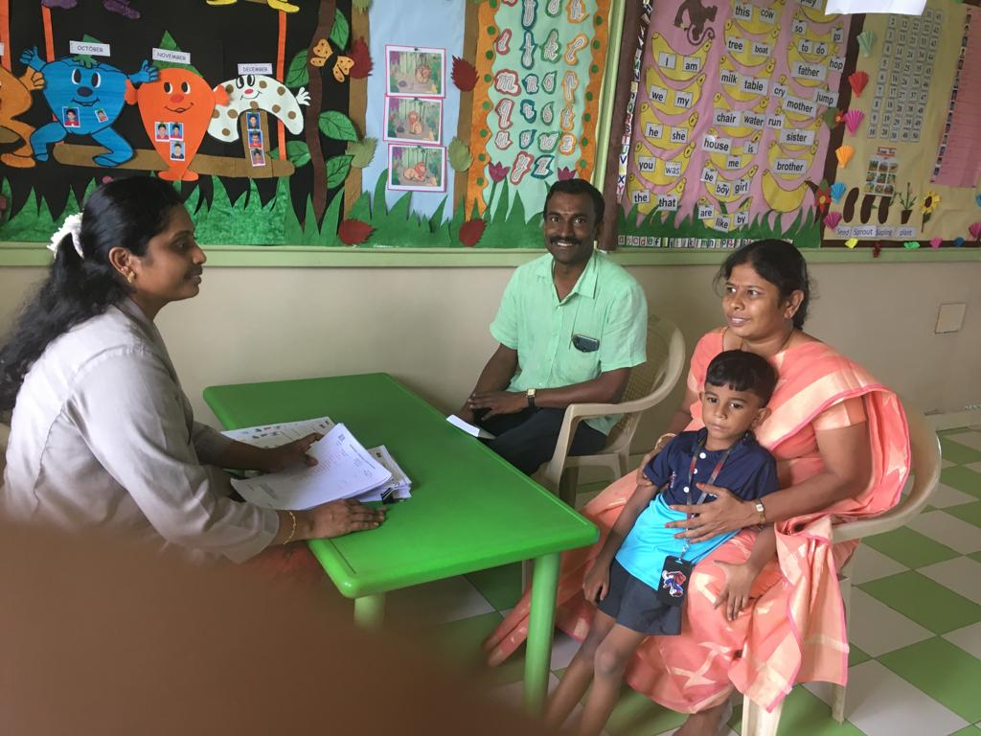

Slide 12
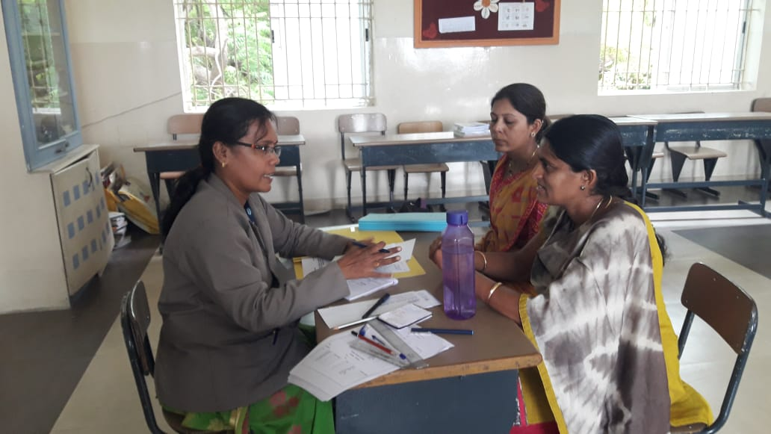
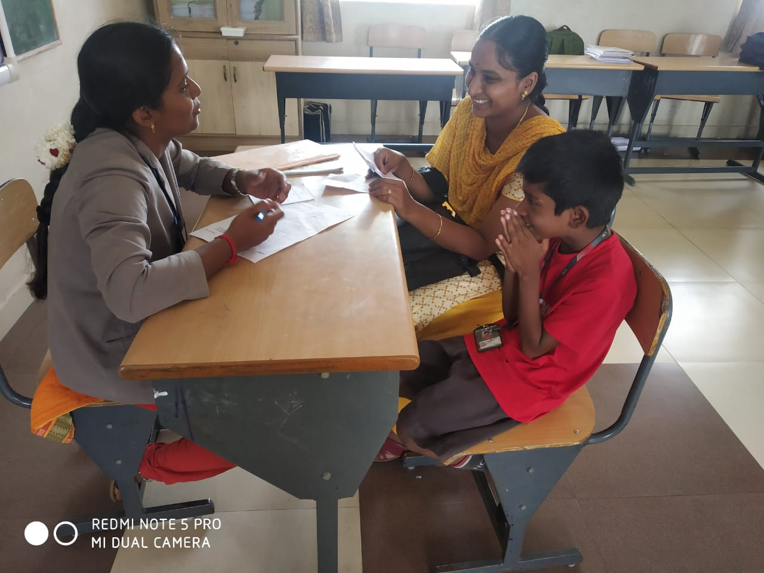
Open day

Slide 13
Development of Hindi

Slide 14
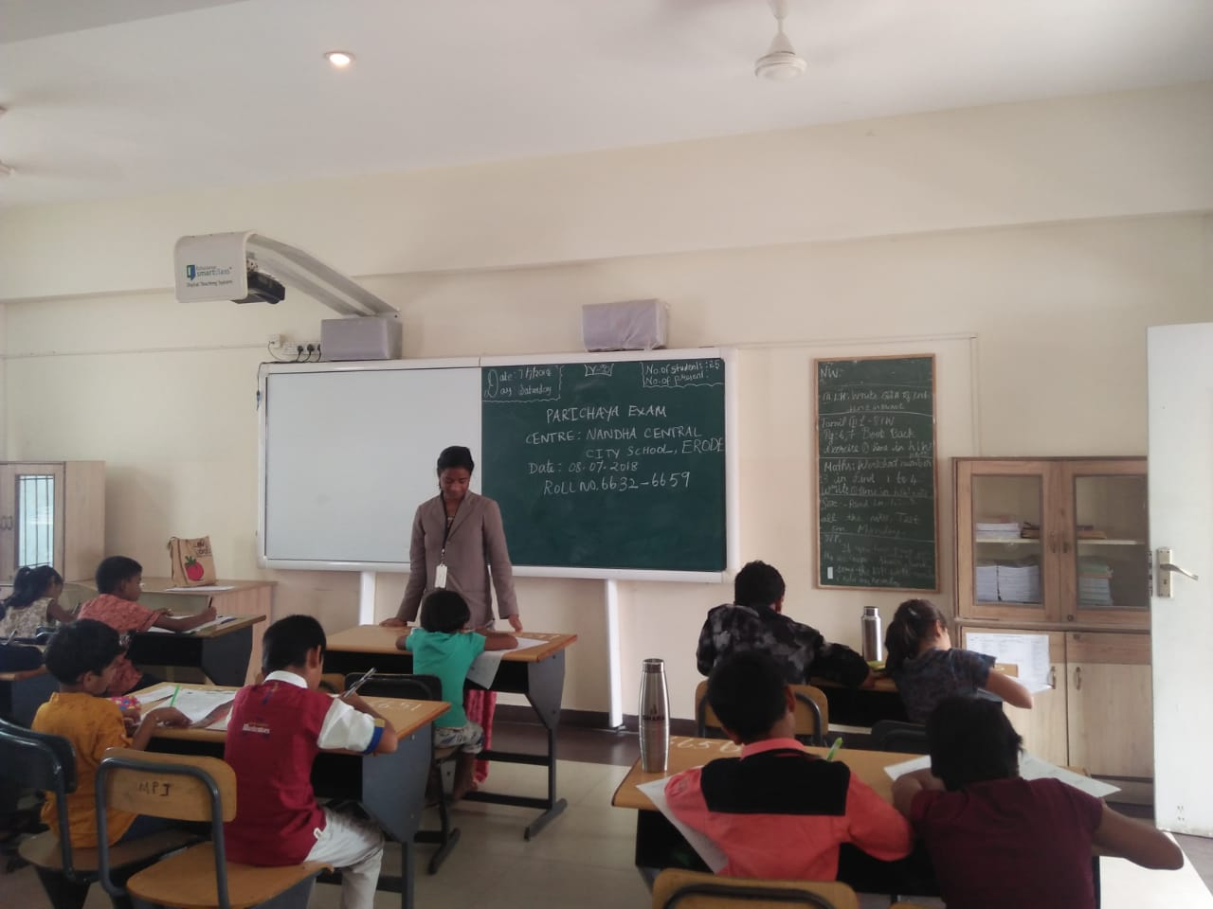
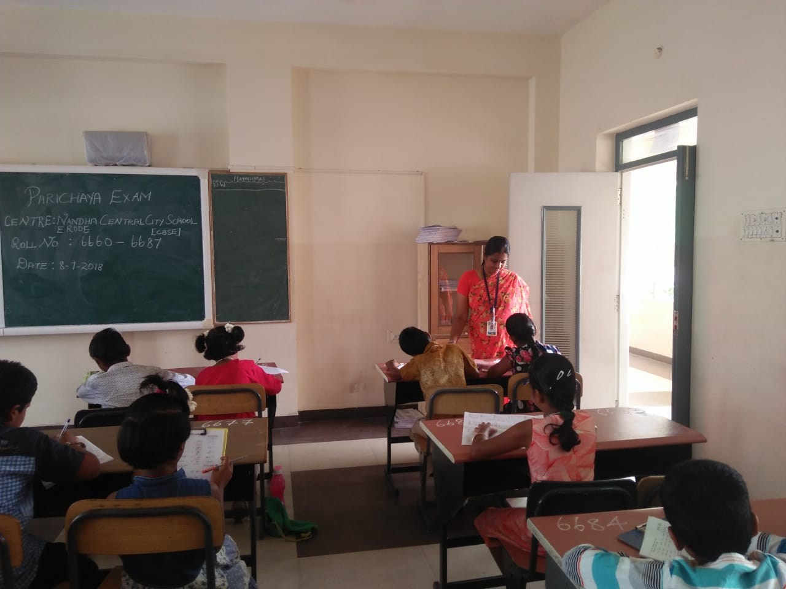
CENTRE FOR PARICHAYA EXAM

Slide 15
Doha Competition
Hindi Handwriting Competition
Hindi Olympiad
BolChal

Slide 16
Competitive Exams
Name of the Competition | No. Of Students | Month
WWF - India Wild Wisdom Quiz | 11 | September'19
Green Olympiad | 3 | October'19
Osho Communications - Drawing | 25 | October'19
English Olympiad | 14 | October'19
World Genius Search Examination | 5 | November'19
Hindu Step English Olympiad | 16 | December'19
Hindi Olympiad | 7 | December'19

Slide 17
Total Number of Prizes in Scholastic Area - 189

Slide 18
Innovation Day
Name of student | Grade | Prize
Shyam Prasad & Nithieswar | VI | I st
Maghima , Shrihanu & Sudhiksha | V | I st
Nagul karthi & Suganth | VII | 2 nd

Slide 19
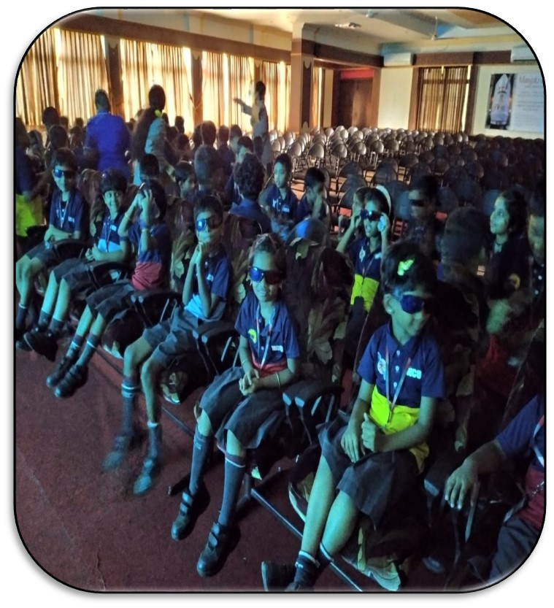
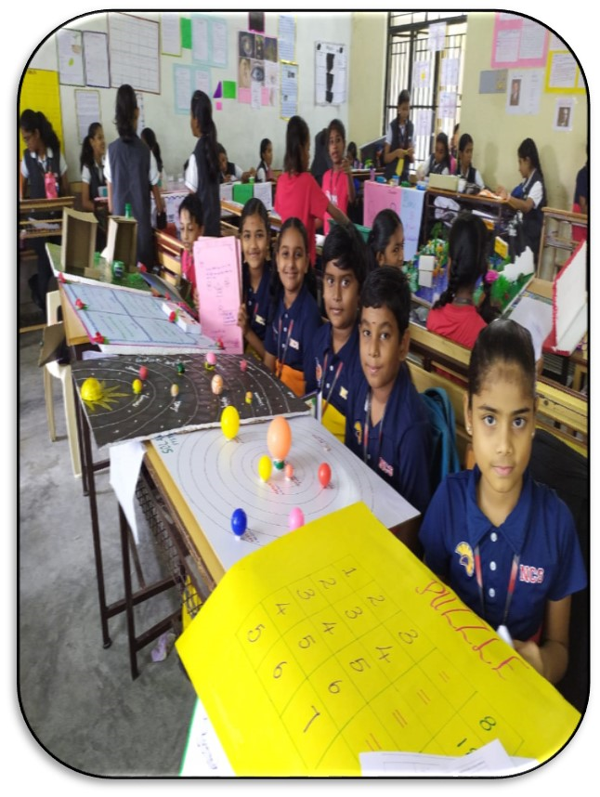

Slide 20
Field Trips for Montessori students

Slide 22
Temple Visit – 28th June, 2019
Pottery – 31st July, 2019
Farm Visit – 09th September,2019
Jaggery Unit
Park Visit

Slide 23
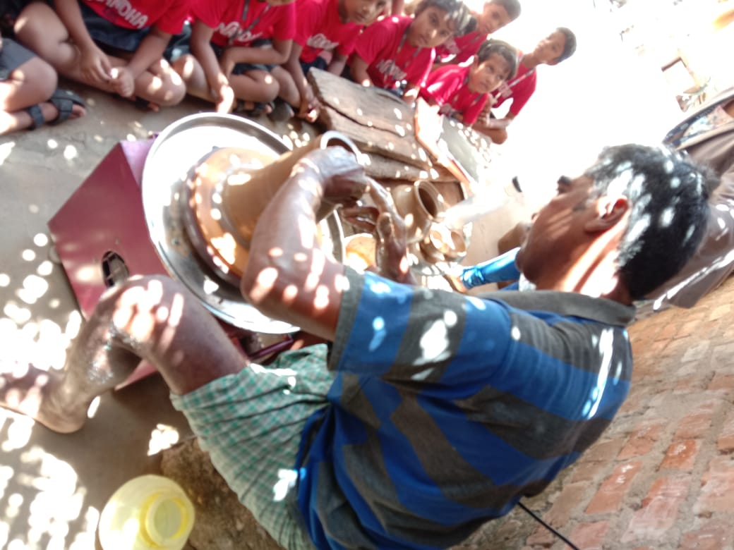
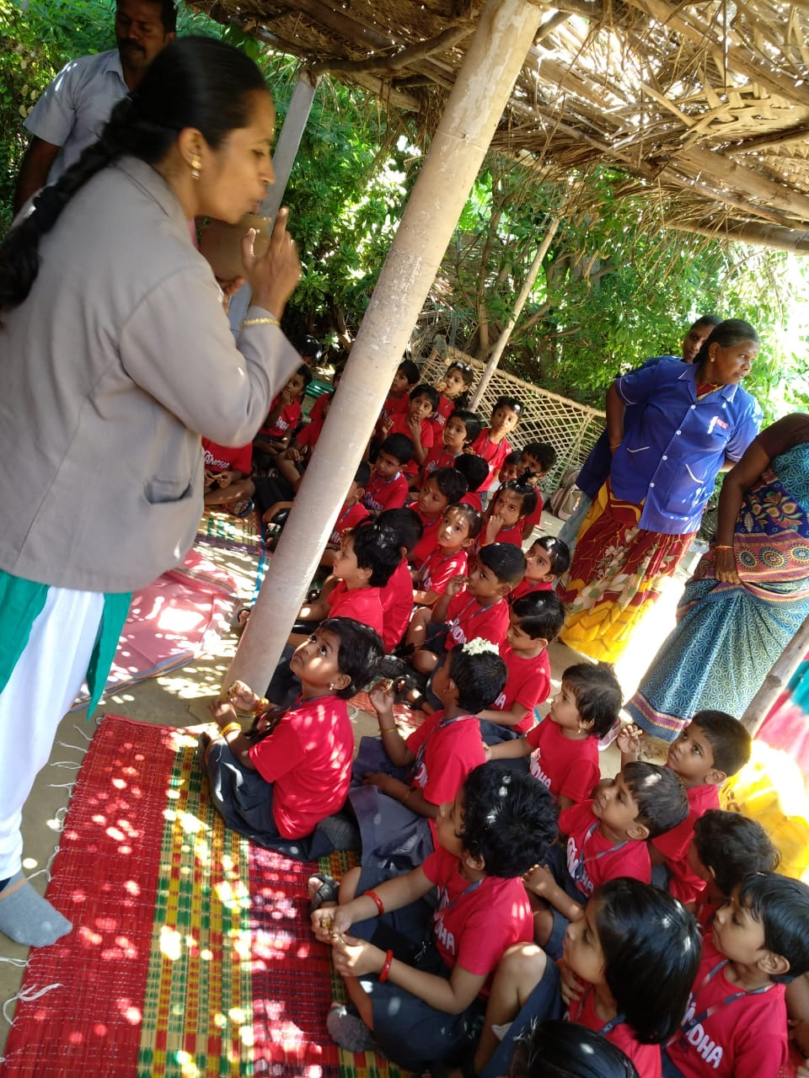
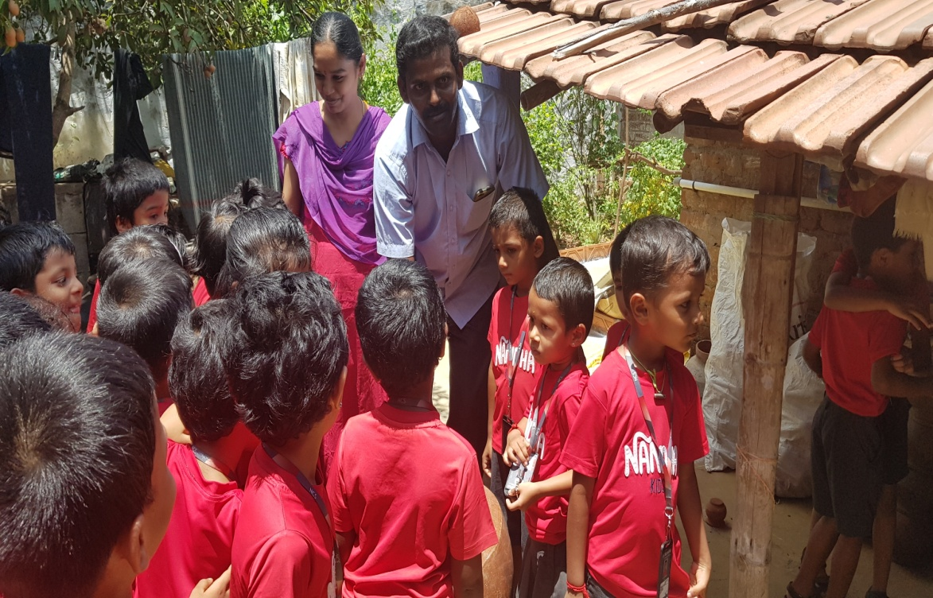
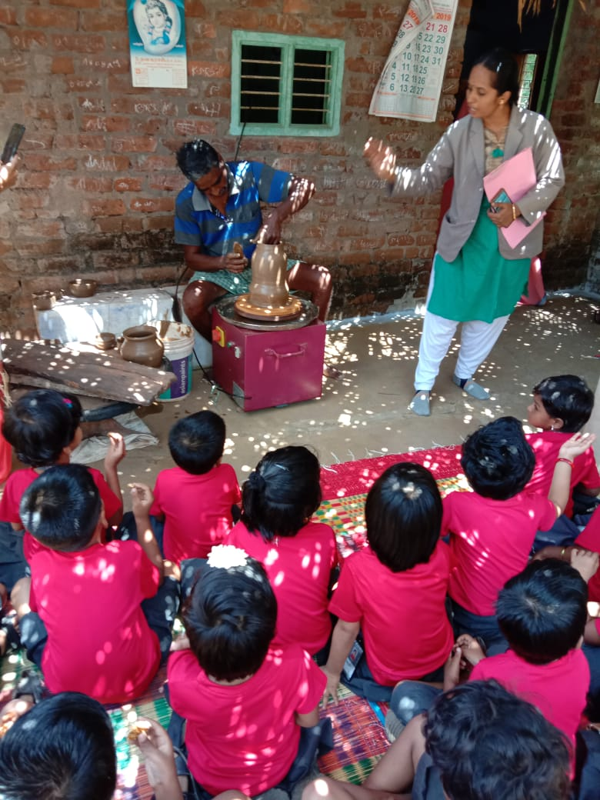

Slide 24
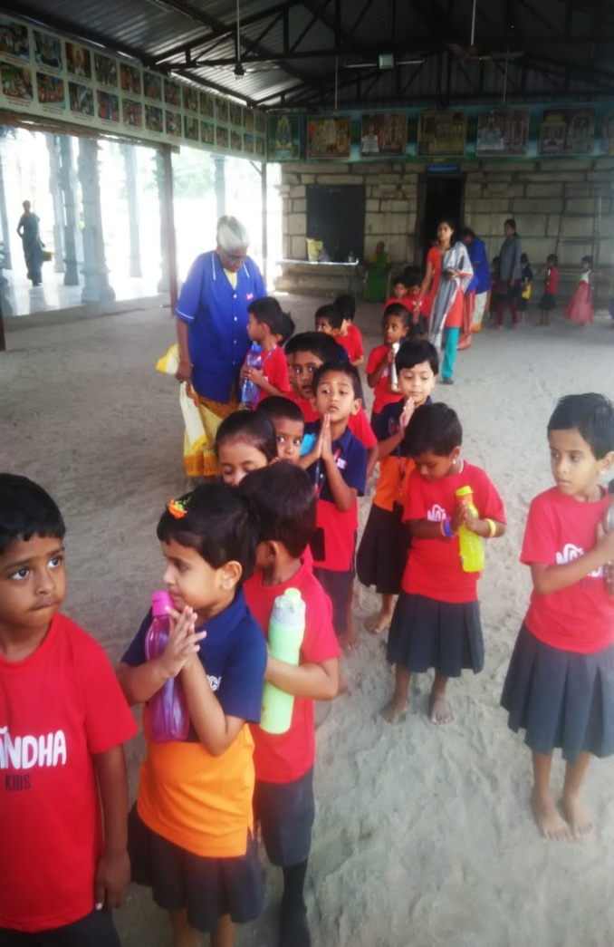

Slide 25
Student Exposure Programme
21st June,2019 – Aavin
20th July,2019 – Milk Bread
18th October,2019 – Farm Visit
22nd October - Reliance Mall &
Medical Shop
23rd October -Agricultural Fields &
Garments

Slide 26
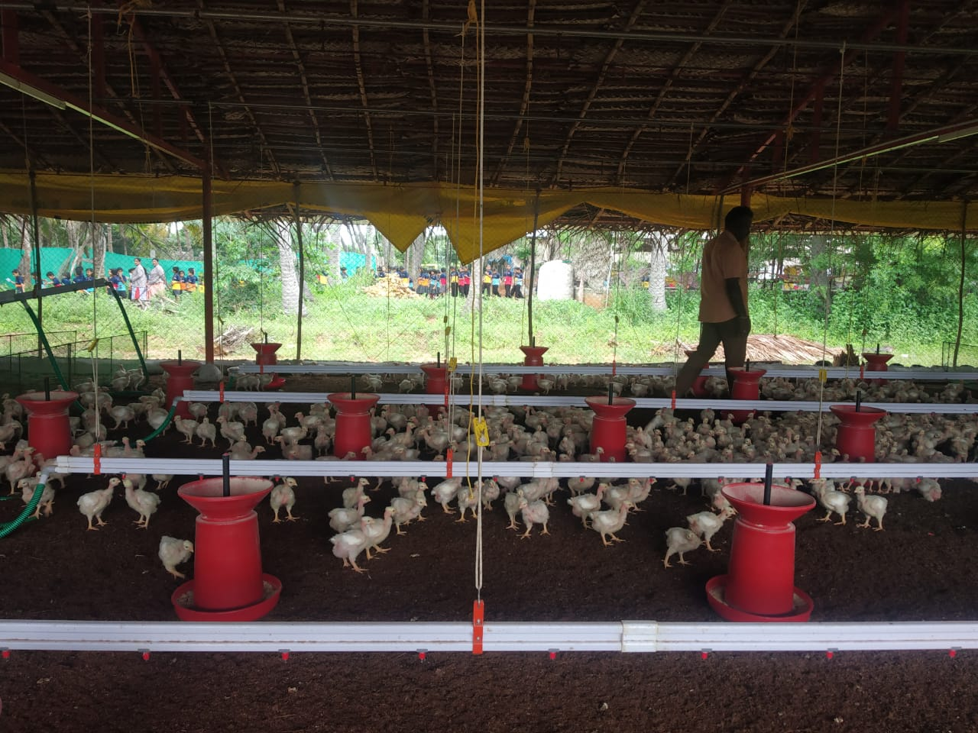
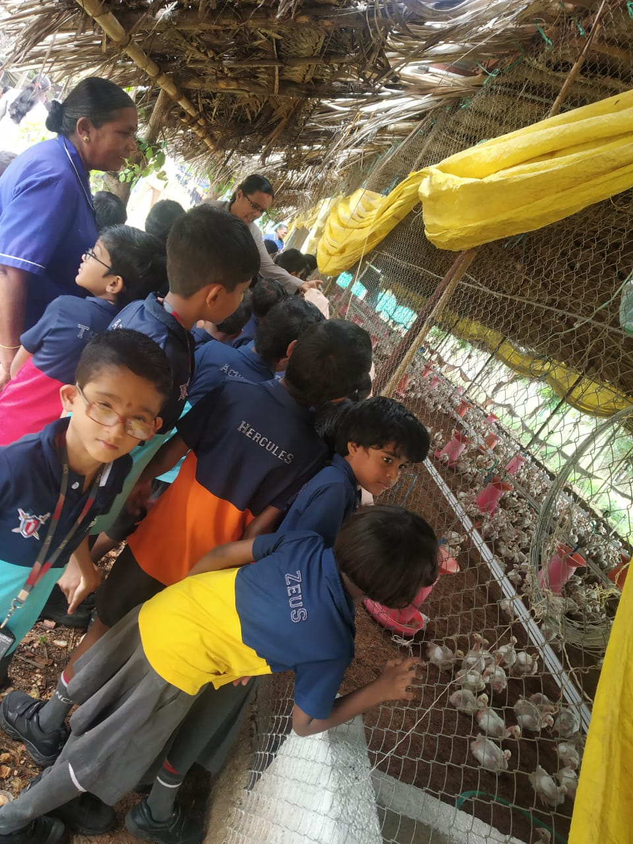
Field trip on 18th october to Skm industries

Slide 27
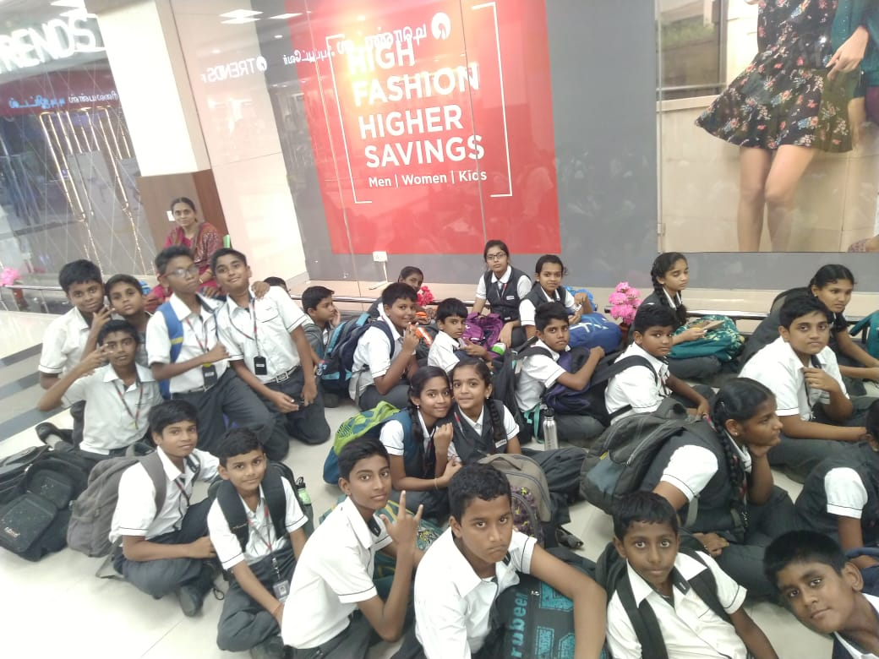
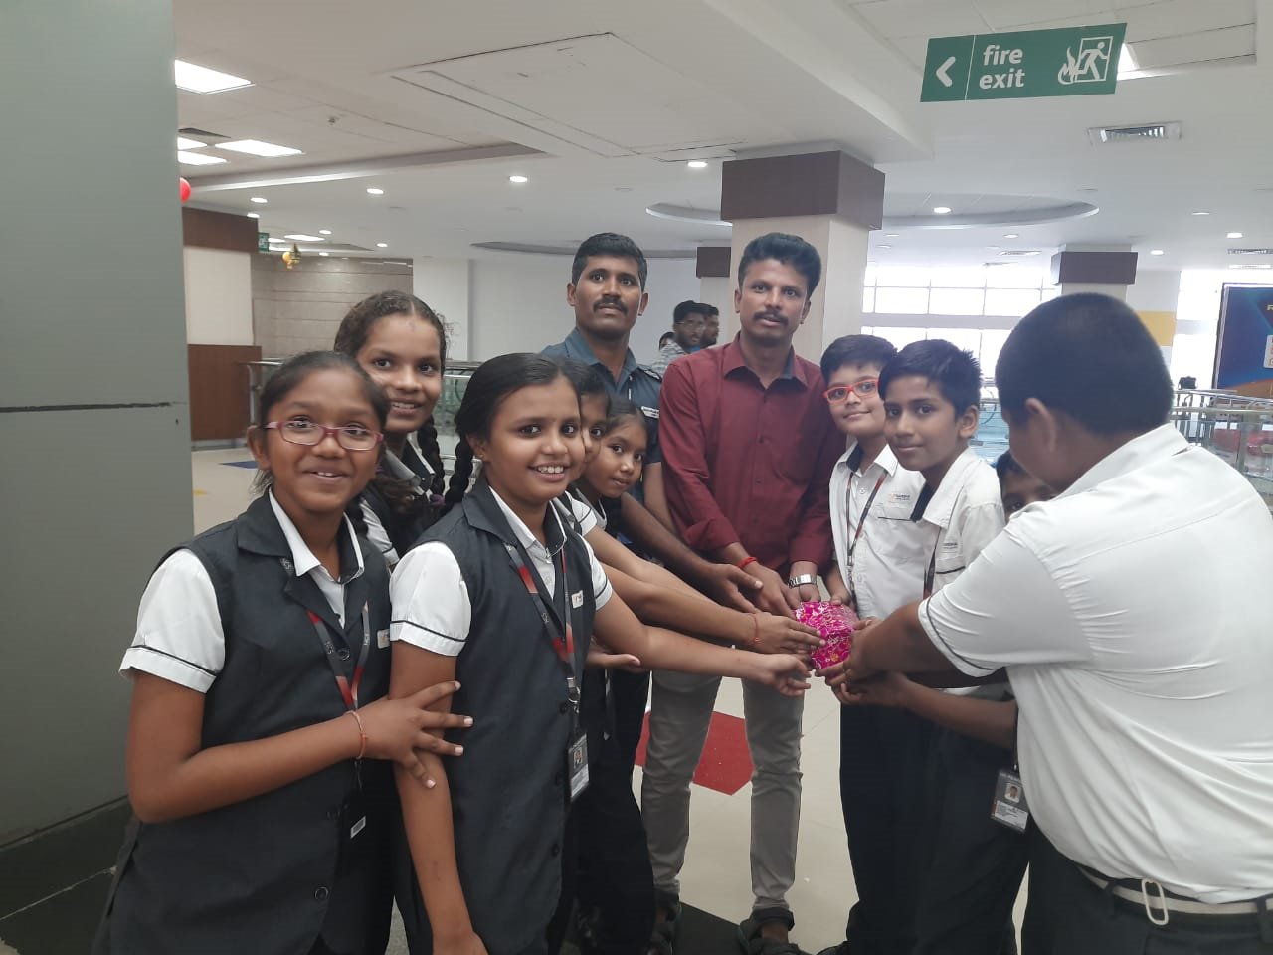

Slide 28
Skill Development Training for Class IX & XI Students
Career Guidance Program from Ashoka University, Haryana
Career Guidance Program from Edu Change
Leadership Training Program by Mrs.Niroopadevi
Effective Public Speaking from JCI, International

Slide 29
Allen
Trained Teachers
14 periods per week
Class 6 – 9
Physics, Chemistry, Biology, Mathematics, Social Science, Mental Ability, English

Slide 30
Levels of Allen Online Test:
Foundation
Advanced
Excellent
Felicitation of rank holders.
IIT, NIT, Medical college visits.

Slide 31
Master Jee
JEE
NEET
NATA
Class XI and XII
Physics, Chemistry, Biology, Mathematics,

Slide 32
Cube Academy
Class XI and XII
CA
LLB
CMA
B.Com Entrance
Trained Faculty

Slide 33
Prominent ACHIEVEMENTS

Slide 34
108 students participated in Tamil Olympiad Competition by Humming Bird Pvt. Ltd.

Slide 35
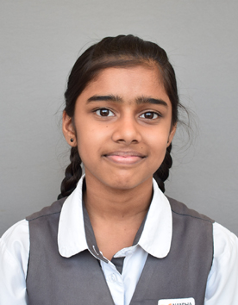
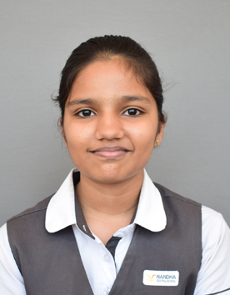
PCRA Sakshan Essay Writing competition

Slide 36
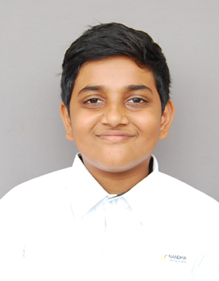
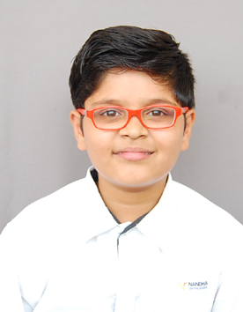
Clay mounting

Slide 37
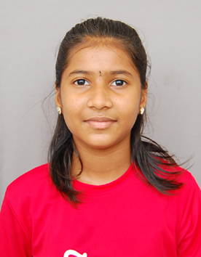
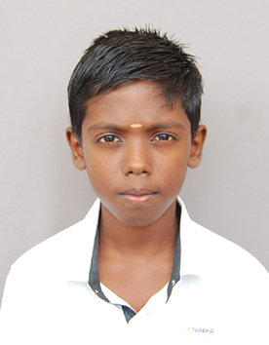
Qualified for round 2 in Byju’s GK exam

Slide 38
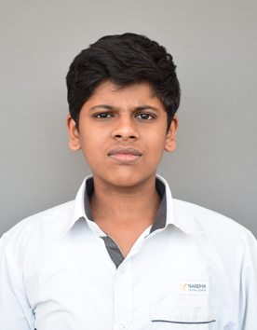
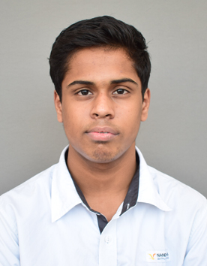
Times Aqua Regia quiz competition.

Slide 39
9 students won School Level and 4 students won in district Level and 4 students won State Level VVM National Level Scholarship Exam conducted by Govt. of India

Slide 40
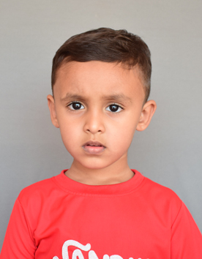
Happy Pose 2019 selfie contest

Slide 41
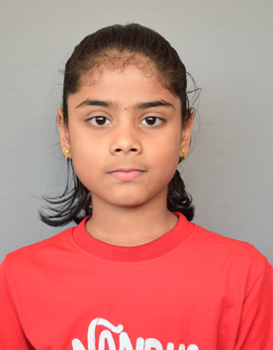
Spell Bee English Olympiad

Slide 42
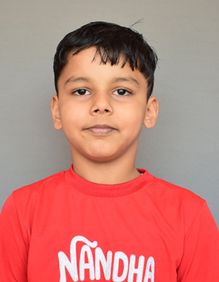
Tirupur Sahodaya Speech competition

Slide 43
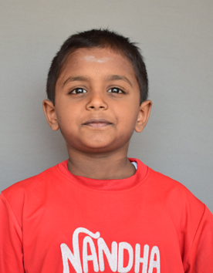
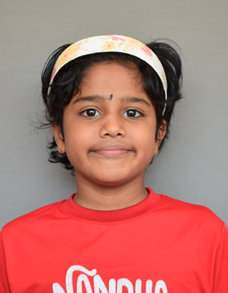
Abacus organised by Alpha Kids world.

Slide 44
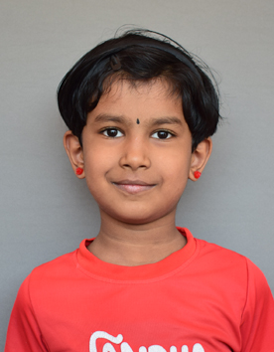
Quiz competition by JCI

Slide 45
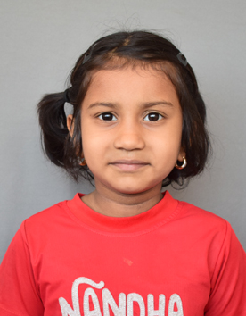
Speech competition by Modern School

Slide 46
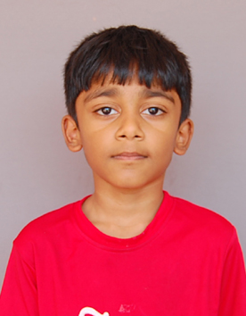
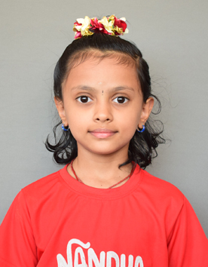
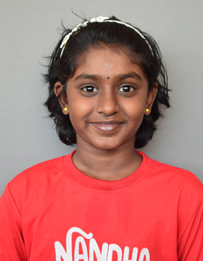
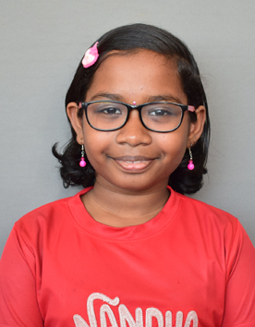
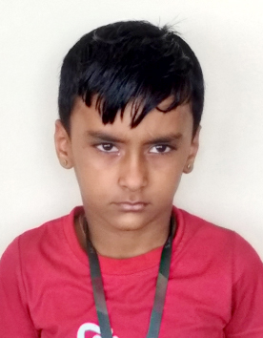
Drawing

Slide 47
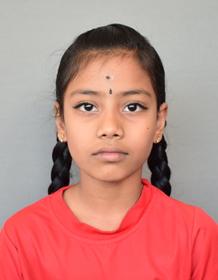
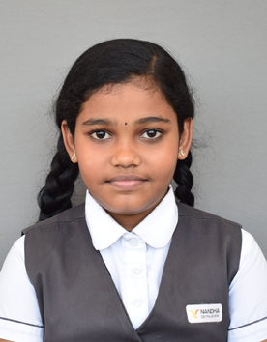
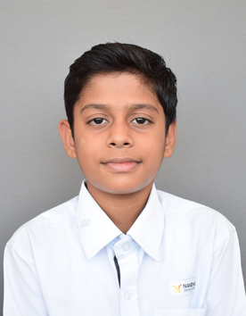
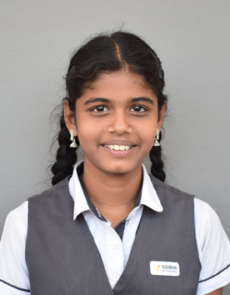
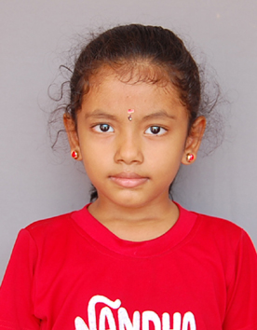
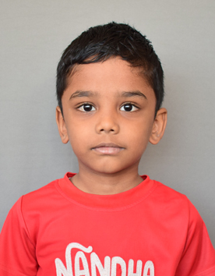
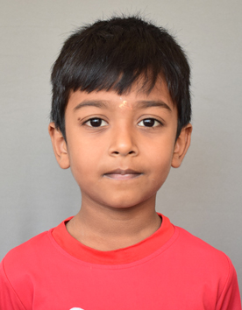
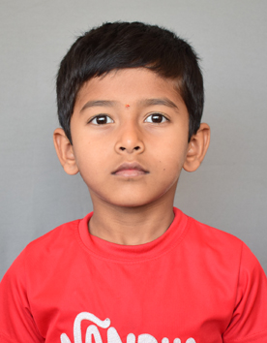
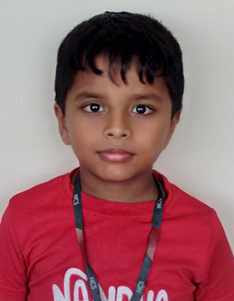

Slide 48
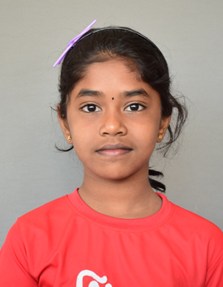

Slide 49
Number of Prizes in Co-Scholastic Areas
SNO | Events | Prizes
1 | Essay Writing, Quiz, Clay mounting, Speech | 51
2 | Drawing | 25
 | Total | 76

Slide 50
CBSE Achievements in co-scholastic areas

Slide 51
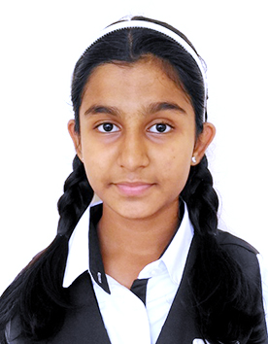
Music and Dance
Music competition conducted by CBSE Sahodaya.

Slide 52
Dance competition

Slide 53
Dance Competition

Slide 54
Yoga
Yoga competition by Tirppur sahodaya

Slide 55
Yoga Competition

Slide 56
Yoga competition

Slide 57
Swimming

Slide 62
Chess

Slide 63
Skating

Slide 64
Sports and Games

Slide 65
BOYS
8th place in cluster south zone volley ball tournament.
Selected as winner in cbse volley ball match organised by cbse tirupur sahodaya.
Selected as runner in cbse volley ball match organised by cbse tirupur sahodaya.
Selected as winner in cbse volley ball match organised by erode sahodaya.
Selected as runner in cbse volley ball match organised by erode sahodaya.
Got 3rd place in cbse football match organised by cbse tirupur sahodaya.
Got 3rd place in cbse Football match organised by Tamilnadu state level open tournament.

Slide 66
Junior Athletic organised by Tirupur Sahodaya

Slide 67
Carrom

Slide 68
Archery

Slide 69
Karate

Slide 70
Cycling Competition

Slide 71
Number of Prizes in Sports and Games
S.No | Event | Prizes
1 | Yoga | 22
2 | Swimming | 120
3 | Chess | 21
4 | Skating | 11
5 | Archery | 5
6 | Karate | 4
7 | Games | 13
8 | Carrom | 8
9 | Cycling | 2
 | Total | 206

Slide 72
High Lights of NCS City Campus

Slide 73
News paper reading

Slide 74
News watching

Slide 75
spoken hindi

Slide 76
meditation

Slide 77
Co- scholastic programmes EVENING SPORTS
EVENING SPORTS

Slide 78
Proctor

Slide 79
Story Writing

Slide 80
Work Education

Slide 81
sports and games

Slide 82
Throw ball
VOLLEY ball

Slide 83
Volley ball
THROW ball

Slide 84
Basket ball

Slide 85
Foot Ball

Slide 86
chess

Slide 87
Field events

Slide 90
Best School Award

Slide 92
Best Community &Collaboration School.
Best school in co-curricular.
Best academic Excellence Activities
Best School of Kongu Region

Slide 93
City Campus Staff Award

Slide 94
Our Honourable Prinicipal Mr. A. G. Prakash Nair
Silver Zone Performance Award by Siverzone Olympiads
Dr.Sarvepalli Radhakrishnan School Exdcellence Award Award
National level Science Talent Search Exam by Unified Council
Best Academic Results award in International Olympiads

Slide 96
OUR RESPECTED PRINCIPAL SIR HAS BEEN SELECTED FOR IC3 CONFERENCE HELD AT MUMBAI FOR 7 DAYS AS ONE AMONG THE 84 SCHOLARS WORLD-WIDE

Slide 97
Global Education and Economic Development Forum Awarded
“Pride Of India Award – 2019” for our
Honorable Principal Sir .

Slide 98
Our Yoga Teacher Mrs. Gayathri has recognised as Best Yoga Master Award from Padmashri Gnanambal by Tirupur District Yogasana Association

Slide 99
Mrs. Gayathri.R – Yoga Teacher attended International Sky Doctor’s conference

Slide 100
Ms.Deepthi got First in State level Yoga competition at J.J College, Trichy.

Slide 101
Mr .Arjunan acted as a judge for Explore Junior Dance Championship

Slide 102
Mr.Arjunan is selected as Choreographer of Radio Mirchi Kallori stars 2019

Slide 103
Mr. Arjunan selected in World of Dance as Regional finalist, Chennai

Slide 104
Mr.Arjunan is selected to compete at Body Rock Asia Dance Competition at Philippines

Slide 105
Mr. Sunil got Best Coach Award from Optimus School

Slide 106
State Kerala Master’s Swimming Championship.

Slide 107
Intra House sports Events
Schedule for Montessori Compartment
Name of Events | Date | Participants | No. Of Students
Hurdles | July 22 & 23,2019 | M1, M2 & M3 | 220
Happy Feet | July 23 & 24 ,2019 | M2 & M3 | 195
Shuttle Run | July 24,2019 | M3 | 110
Collecting Bean Bag & Ball Relay | July 25,2019 | M2 & M3 | 195

Slide 109
Schedule for Primary Compartment
Name of the Events | Class | Date | Winners
50 mts frog jump | Grade 3 | June 10,2019 | 24
60 mts running , rolling ball | Grade 3 | June 11,2019 | 24
50 mts frog jump | Grade 1 | June 12,2019 | 24
Tennis ball throw, collecting cones | Grade 1 | June 19,2019 | 23
60 mts running , rolling ball | Grade 1 | June 26,2019 | 20
Hoops running, collecting cones | Grade 4 | July 02,2019 | 24
Shot put 50 mts | Grade 1 | July 03,2019 | 24
Cricket ball throw | Grade 4 | July 08,2019 | 24
Hoops running, collecting cones | Grade 2 | July 10,2019 | 24
Tennis ball throw ,100 mts running | Grade 2 | July 17,2019 | 24

Slide 111
Schedule for Middle & Secondary Compartment
Name of the Events | Class 5 & 6 | Class 7 to 10 | Class 11 & 12
Boys - Volley ball | 10-Jun-19 | 11-Jun-19 | 13-Jun-19
Girls - Basket ball
Boys - Foot ball | 17-Jun-19 | 18-Jun-19 | 20-Jun-19
Girls - Throw ball
Boys - Throw ball | 24-Jun-19 | 25-Jun-19 | 27-Jun-19
Girls - Chess
Boys – Chess, Carrom | 01-Jul-19 | 02-Jul-19 | 04-Jul-19
Girls - Volley ball, & Tennikoit
Boys - Long Jump, Shot put, Discus throw | 09-Jul-19 | 10-Jul-19 | 11-Jul-19
Girls – 100 mts, 800 mts, 4x100 mts relay
Boys – 100 mts, 800 mts, 4x100 mts relay | 15-Jul-19 | July 16, 2019 | 18-Jul-19
Girls - Long Jump, Shot put, Discus throw

Slide 113
Intra School Competitions in co-scholastic areas Competitions for Primary & Middle School
Date | Class | Competitions | Department
July 6 | 1 to 8 | Eccentric | English
July 20 | 1 to 8 | Scientia | Science
Aug 9 | 1 to 8 | Vani Vikas Prathispardha | Hindi
Oct 5 | 1 to 8 | Technovation | Computer
Oct 11 | 6 to 8 | Seminar | English
Oct 11 | 3 to 8 | Inter-School Doha Competition | Hindi
Oct 25 | 1 to 8 | Inter School Thirukural Competition | Tamil
Nov 2 | 1 to 8 | Thanithiran Potigal | Tamil
Nov 7 | 3 to 8 | Inter-house-musical contest ‘Swarang’ | Houses
Nov 16 | 1 to 8 | Cruise | Social
Dec 10 | 1 to 8 | Math Bee | Maths
Jan 6&7 | 5 to 9,11 | Inter-School sports meet | Physical Education
Jan 10 | 6 to 8 | Seminar | English
Feb 18 | 4 to 8 | Spoken Hindi Assessment | Hindi

Slide 114
ECCENTRIC – ENGLISH DEPT

Slide 115
SCIENTIA – SCIENCE DEPT.

Slide 116
Competitions - Montessori
Date | Competitions
Jul-24 | Masquerade
Aug-21 | Slogan recitation
Sep-27 | Tale
Nov-14 | Elocution (M1,M3), Colouring(M1)
Dec-11 | Bharathiyan ‘19

Slide 118
Celebrations
S.No | Celebration | Month & Date | Organising Department
1 | Investiture ceremony | June 19, 2019 | Middle, Secondary & Sr. Secondary
2 | Aadiperuku | August 1, 2019 | Montessori
3 | Bakrid | August 9, 2019 | Primary
4 | Independence Day | August 15, 2019 | Middle
5 | Krishna Jayanthi | August 22, 2019 | Montessori
6 | Vinayagar Chathurthi | August 31,2019 | Primary
7 | Teacher’s Day | September 5, 2019 | Primary
8 | Onam | September 9, 2019 | Montessori
9 | Muharram | September 9, 2019 | Middle
10 | Gandhi Jayanthi | October 1, 2019 | Middle
11 | Saraswathi Pooja | October 7, 2019 | Montessori
12 | Diwali | October 24,2019 | Primary
13 | Children’s Day | November 14, 2019 | Middle
14 | Christmas | December 24, 2019 | Middle
15 | Pongal | January 13, 2020 | Montessori
16 | Republic Day | January 26, 2020 | Middle
17 | Holi | March 9, 2020 | Primary

Slide 119
Onam Celebration

Slide 120
Krishna Jayanthi

Slide 121
Teachers Day Celebration

Slide 122
Colour days
Blue Day – June 26
Red Day – July 17
Yellow Day – August 14
Green Day – September 25
Orange Day – October 23
Purple Day – November 14
White Day - December 09

Slide 124
OBSERVATIONS OF NATIONAL & INTERNATIONAL DAYS (Classes 3 to 8)
Days | Month & Date | Organising Club
World Anti-Child Labour Day | June 12, 2019 | Photography Club
World Blood Donation Day (CSR Activity) | June 14, 2019 | Interact Club
Doctors’ Day (CSR Activity) | July 1, 2019 | Health Club
World Hiroshima Day | August 6, 2019 | Photography club
International Literacy Day | September 7, 2019 | Drama Club
Wild Life Week | October 3, 2019 | Agriculture Club
World Food Day | October 16,2016 | Health Club
Vigilance Awareness Week | October 29, 2019 | Multimedia Club
Sardar Vallabhai Patel’s Birth Anniversary | October 31, 2019 | Arts Club

Slide 125
Vigilance Awareness Week

Slide 126
Clubs
Club | Club Co-ordinators | Office Bearers
Photography Club | Mrs.Raja Bhuvaneswari & Ms.Aparajita | Srivarsha, Shivanishree, Sudeshna & Anshika
Interact Club | Mrs.Athiyasulthana & Mrs.Bhuvaneshwari | Ankita, Inikaa, Rohit & Aadith
Health Club | Mrs.Anusha & Mr.Gurudev | Madhumitha, Lakshana, Sandhiya & Iniya
Drama Club | Mrs.Shalu Rathi & Mrs.Divya.G | Hari Krithik, Nandhana, Arjun & Harshan
Agricultural club | Mrs.Manjulakshmi & Mrs.Pushpalatha | Divyansh, Mayushigaa, Hem Kanwar & Sharvin
Multimedia club | Mrs.Manjula & Mrs.Preetha | Mohamed Anfaz, Mayank Sarda, Meera & Thaarunisha
Art Club | Ms.Harinandhini & Mrs.Sathyalakshmi | Arulchelvi, Alia Sharma, Kashish Sharma & Alok Verma
Music club | Mrs.Suganya & MRs.Sindhuja | Sweta.S.V, Thrisha, Srinivi & Varnika.R.s
Manitham Club | Ms.Saranya & Ms.Srijanani | Akilram, Nikitha Roshini, Chamshitha & Ashwathaa

Slide 127
Club | Club Activities | Outcome
Photography Club
Interact Club
Health Club

Slide 128
Club | Club Activities | Outcome
Drama Club
Agricultural club
Multimedia club

Slide 129
Club | Club Activities | Outcome
Art Club
Music club
Manitham Club

Slide 130
Carnival Day

Slide 131
Prize-O-Fest

Slide 132
Investiture Ceremony
Title | Name
Head Boy | Aswini Kumar
Head Girl | Bhavya
Sports Secretary | Pradeep.M
Sports Joint Secretary | Shamrutha.N
House Captains | Meenakshi Kumari.S, Aathira.M, Sameer.S , Gokulnathan.V
House Vice Captains | Gourav Raj Purohit, Pranesh.V, Yuktha jain.V, N.S.Varsha

Slide 133
INVESTITURE CEREMONY

Slide 134
PROGRAMMES FOR PARENTS
Family Bonding Activities
Vegetable carving – July 20
Face Art - October 6
Upcoming Cooking without fire – February 1

Slide 135
Unique Events
Origin ’19- Grandparents Day – September 06
Symphony’19 – November 22
Upcoming Calibration’20 – March 27

Slide 136
We strongly believe in holistic growth of students and school starts with meditation and after which zero1 period is allotted for story telling, story narration and newspaper reading.
During lunch time, news watching happens to update the current affairs.

Slide 137
9 period-system is divided for academics and non-academics following by zero2 period which is allotted for bag checking, handbook writing and drinking water.
To develop the group leadership and collaboration MAKEATHON was conducted for Class 9 students and they did wonderful presentations and projects.

Slide 138
In order to develop the creative skill of the students, story writing record has been introduced.
For class 6-9, in-plant training was conducted by allowing them to visit the different segments of Reliance Mall,
6 medical shops, agriculture fields and garment industries.

Slide 139
Students were given pre-in-plant training before the visit of place of interest. After in-plant training over, as post-in-plant training segment, we allowed the students to write the record.

Slide 140
Origin 2019

Slide 141
Symphony

Slide 142
PROFESSIONAL DEVELOPMENT PROGRAMMES FOR TEACHERS
Topic | Presented by
X - Seed Training | X- Seed Training
Mathematics FDP | Dr. Padmanaban
Computer Science FDP | Chrysalis
EVS, Science and social FDP | Mrs. Kokila
Tamil FDP | Mr. Manikandan
Hindi FDP | Mrs. Sharmatha
Montessori FDP | Mr. Selvakumar
Profile PPT Soft skill | NCCS staff
X - Seed Training | X- Seed Training
Extra Marks Training | Mr. Saravanan
Thulir Publications | Mr. Manikandan
Creative Thinking & Work life Balance | Mr. Devaraj
Classroom Management and Communicative English | Mr. Selvakumar
Enhancing child understanding power | Extra Marks Trainer
Leadership | Miss. Niroopa Ravikumar
Who am I, I can…Leadership | Miss. Vidhyasruthi

